Slide 1
Cohort State-Transition Models
Decision Modeling for Public Health
November 2020

Slide 2
Cohort State-Transition Modeling Overview
Notes:
Part 1 = Showing code 3 state model
Part 2 = Exercise build Sick-Sicker model
Part 3 = Show answers of Sick-Sicker

Slide 3
Cohort State-Transition Models
Model that describes how a cohort is distributed across health states over time
e.g., healthy, sick, stable, progressed, dead
Allow transitions between states with some probability
Transitions are modeled in discrete time steps (e.g. weekly, monthly, yearly)

Slide 4
Cohort Model Assumptions
Health states are mutually exclusive, collectively exhaustive
Within a given health state, population is homogeneous
Markovian assumption: transition probabilities depends only on current health state (“memoryless”)

Slide 5
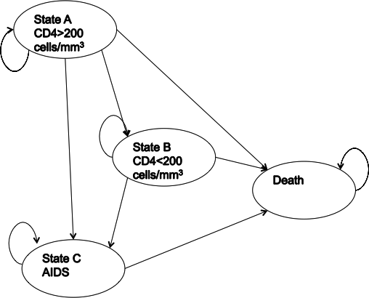
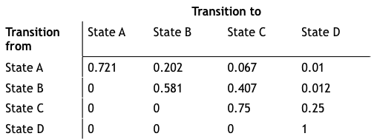
Simple State-Transition Model of HIV Progression
Transition probability matrix
State-transition diagram
Drummond, Michael F. Methods for the economic evaluation of health care programmes. Oxford university press, 2005.

Slide 6
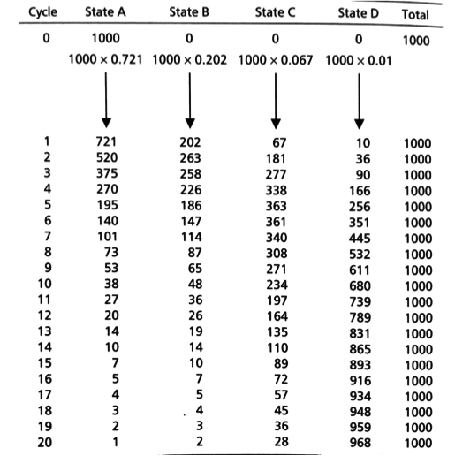
Cohort
"Trace”
Number or proportion of individuals at each time step

Slide 7
Simple 3-State Example
Notes:
Part 1 = Showing code 3 state model
Part 2 = Exercise build Sick-Sicker model
Part 3 = Show answers of Sick-Sicker

Slide 8
Three-State Model
p_HH
p_HS
p_SS
Healthy (H)
Sick (S)
p_HD
p_SD
Dead (D)
To:
 | Healthy | Sick | Dead
Healthy | p_HH | p_HS | p_HD
Sick | 0 | p_SS | p_SD
Dead | 0 | 0 | p_DD
p_DD
From:

Slide 9
Three-State Model
0.05
0.93
p_HS
0.90
1 - 0.02 - 0.05
1 - 0.10
p_HH
p_SS
Healthy (H)
Sick (S)
p_HD
p_SD
0.02
0.10
Dead (D)
To:
 | Healthy | Sick | Dead
Healthy | p_HH | p_HS | p_HD
Sick | 0 | p_SS | p_SD
Dead | 0 | 0 | p_DD
p_DD
1.0
From:

Slide 10
Three-State Model
0.05
0.93
p_HS
0.90
1 - 0.02 - 0.05
1 - 0.10
p_HH
p_SS
Healthy (H)
Sick (S)
p_HD
p_SD
0.02
0.10
Dead (D)
To:
 | Healthy | Sick | Dead
Healthy | 0.93 | 0.05 | 0.02
Sick | 0 | 0.90 | 0.10
Dead | 0 | 0 | 1.0
p_DD
1.0
From:

Slide 11

Simulate the Cohort over Time
Initial cohort distribution:
Cohort distribution at next time step is calculated through matrix multiplication
x₀ = [1.0 0.0 0.0]
(everyone starts healthy)
Transition Probability Matrix
$$P$$
x_{t+1}
=
x_{t}

Slide 12
Simulate the Cohort over Time
Initial cohort distribution:
Cohort distribution at next time step is calculated through matrix multiplication
x₀ = [1.0 0.0 0.0]
(everyone starts healthy)
x₁
x₀
0.93
0.05
0.02
x_{t+1}
=
1.0
x_{t}
0
0.90
0.10
0.0
0.0
0
0
1.0

Slide 13
Simulate the Cohort over Time
Initial cohort distribution:
Cohort distribution at next time step is calculated through matrix multiplication
x₀ = [1.0 0.0 0.0]
(everyone starts healthy)
x₁
x₀
0.93
0.05
0.02
0.93
=
1.0
0.0
0.0
0
0.90
0.10
0
0
1.0
(0.93)(1.0) + (0.0)(0.0) + (0.0)(0.0)
(p_{Healthy,Healthy} )*Pr(healthy) + (p_{Sick,Healthy} )*Pr(sick) + (p_{Dead,Healthy} )*Pr(dead)

Slide 14
Simulate the Cohort over Time
Initial cohort distribution:
Cohort distribution at next time step is calculated through matrix multiplication
x₀ = [1.0 0.0 0.0]
(everyone starts healthy)
x₁
x₀
0.93
0.05
0.02
x_{t+1}
=
1.0
x_{t}
0
0.90
0.10
0.93
0.05
0.0
0.0
0
0
1.0
(0.05)(1.0) + (0.90)(0.0) + (0.0)(0.0)

Slide 15
Simulate the Cohort over Time
Initial cohort distribution:
Cohort distribution at next time step is calculated through matrix multiplication
x₀ = [1.0 0.0 0.0]
(everyone starts healthy)
x₁
x₀
0.93
0.05
0.02
x_{t+1}
=
1.0
x_{t}
0
0.90
0.10
0.93
0.05
0.02
0.0
0.0
0
0
1.0

Slide 16
Simulate the Cohort over Time
Initial cohort distribution:
Cohort distribution at next time step is calculated through matrix multiplication
x₀ = [1.0 0.0 0.0]
(everyone starts healthy)
x₂
x₁
0.93
0.05
0.02
0.87
x_{t+1}
=
0.93
0.05
0.02
0
0.90
0.10
0
0
1.0
(0.93)(0.93) + (0.0)(0.05) + (0.0)(0.02)

Slide 17
Simulate the Cohort over Time
Initial cohort distribution:
Cohort distribution at next time step is calculated through matrix multiplication
x₀ = [1.0 0.0 0.0]
(everyone starts healthy)
x₂
x₁
0.93
0.05
0.02
0.87
x_{t+1}
=
0.93
0.05
0.02
0
0.90
0.10
0.09
0
0
1.0
(0.05)(0.93) + (0.90)(0.05) + (0.0)(0.02)

Slide 18
Simulate the Cohort over Time
Initial cohort distribution:
Cohort distribution at next time step is calculated through matrix multiplication
x₀ = [1.0 0.0 0.0]
(everyone starts healthy)
x₂
x₁
0.93
0.05
0.02
0.87
x_{t+1}
0.04
=
0.93
0.05
0.02
0
0.90
0.10
0.09
0
0
1.0
(0.02)(0.93) + (0.10)(0.05) + (1.0)(0.02)

Slide 19
Simulate the Cohort over Time
Cohort distribution over time:
Cohort trace:
x₃ = [0.80 0.13 0.07]
x₀ = [1.0 0.0 0.0]
x₁ = [0.93 0.05 0.02]
x₂ = [0.87 0.09 0.04]
x₄ = [0.75 0.15 0.10]

Slide 20
Calculating Model Outcomes
Notes:
Part 1 = Showing code 3 state model
Part 2 = Exercise build Sick-Sicker model
Part 3 = Show answers of Sick-Sicker

Slide 21
Expected outcomes
Expected remaining life-years, quality-adjusted life-years (QALYs), costs
Generally calculated over lifetime
Multiply cohort distribution by state-specific values to calculate expected value at each cycle
Sum expected values over time
discount if desired

Slide 22
Remaining Life-Expectancy
State-specific values: 1 if alive, 0 if dead
State values:
1.0
1.0
0.0
Time | Healthy | Sick | Dead | E[LYs]
0 | 1.0 | 0.0 | 0.0 | --
1 | 0.93 | 0.05 | 0.02 | 0.98
2 | 0.87 | 0.09 | 0.04 | 0.96
3 | 0.80 | 0.13 | 0.07 | 0.93
 | … | … | …
Total life years: 21.0 years

Slide 23
Remaining QALE
Remaining quality-adjusted life-expectancy (QALE)
State-specific values: utility of that state
State values:
0.8
0.5
0.0
Time | Healthy | Sick | Dead | E[QALYs]
0 | 1.0 | 0.0 | 0.0 | --
1 | 0.93 | 0.05 | 0.02 | 0.77
2 | 0.87 | 0.09 | 0.04 | 0.74
3 | 0.80 | 0.13 | 0.07 | 0.71
 | … | … | …
Total QALYs: 14.7 QALYs

Slide 24
Remaining costs
Remaining lifetime health care costs
State-specific values: cost of spending one cycle in that health state
State values:
$400
$1,000
$0
Time | Healthy | Sick | Dead | E[costs]
0 | 1.0 | 0.0 | 0.0 | --
1 | 0.93 | 0.05 | 0.02 | $422
2 | 0.87 | 0.09 | 0.04 | $438
3 | 0.80 | 0.13 | 0.07 | $450
 | … | … | …
Total health care costs: $12,531

Slide 25

Discounting
In cost-effectiveness analysis, costs and QALYs are discounted at some rate, $r$
At each cycle $t$, multiply expected outcome by the discount factor: $\frac{1}{{\left(1+r\right)}^{t}}$
State values:
0.8
0.5
0.0
Time | Healthy | Sick | Dead | E[QALYs]
0 | 1.0 | 0.0 | 0.0 | --
1 | 0.93 | 0.05 | 0.02 | 0.77
2 | 0.87 | 0.09 | 0.04 | 0.74
3 | 0.80 | 0.13 | 0.07 | 0.71
 | … | … | …
Sum
* 1/(1+r)
* 1/(1+r)²
* 1/(1+r)³
Total QALYs: 14.7 QALYs
Total discounted (3% per year) QALYs: 10.2 QALYs

